Slide 1


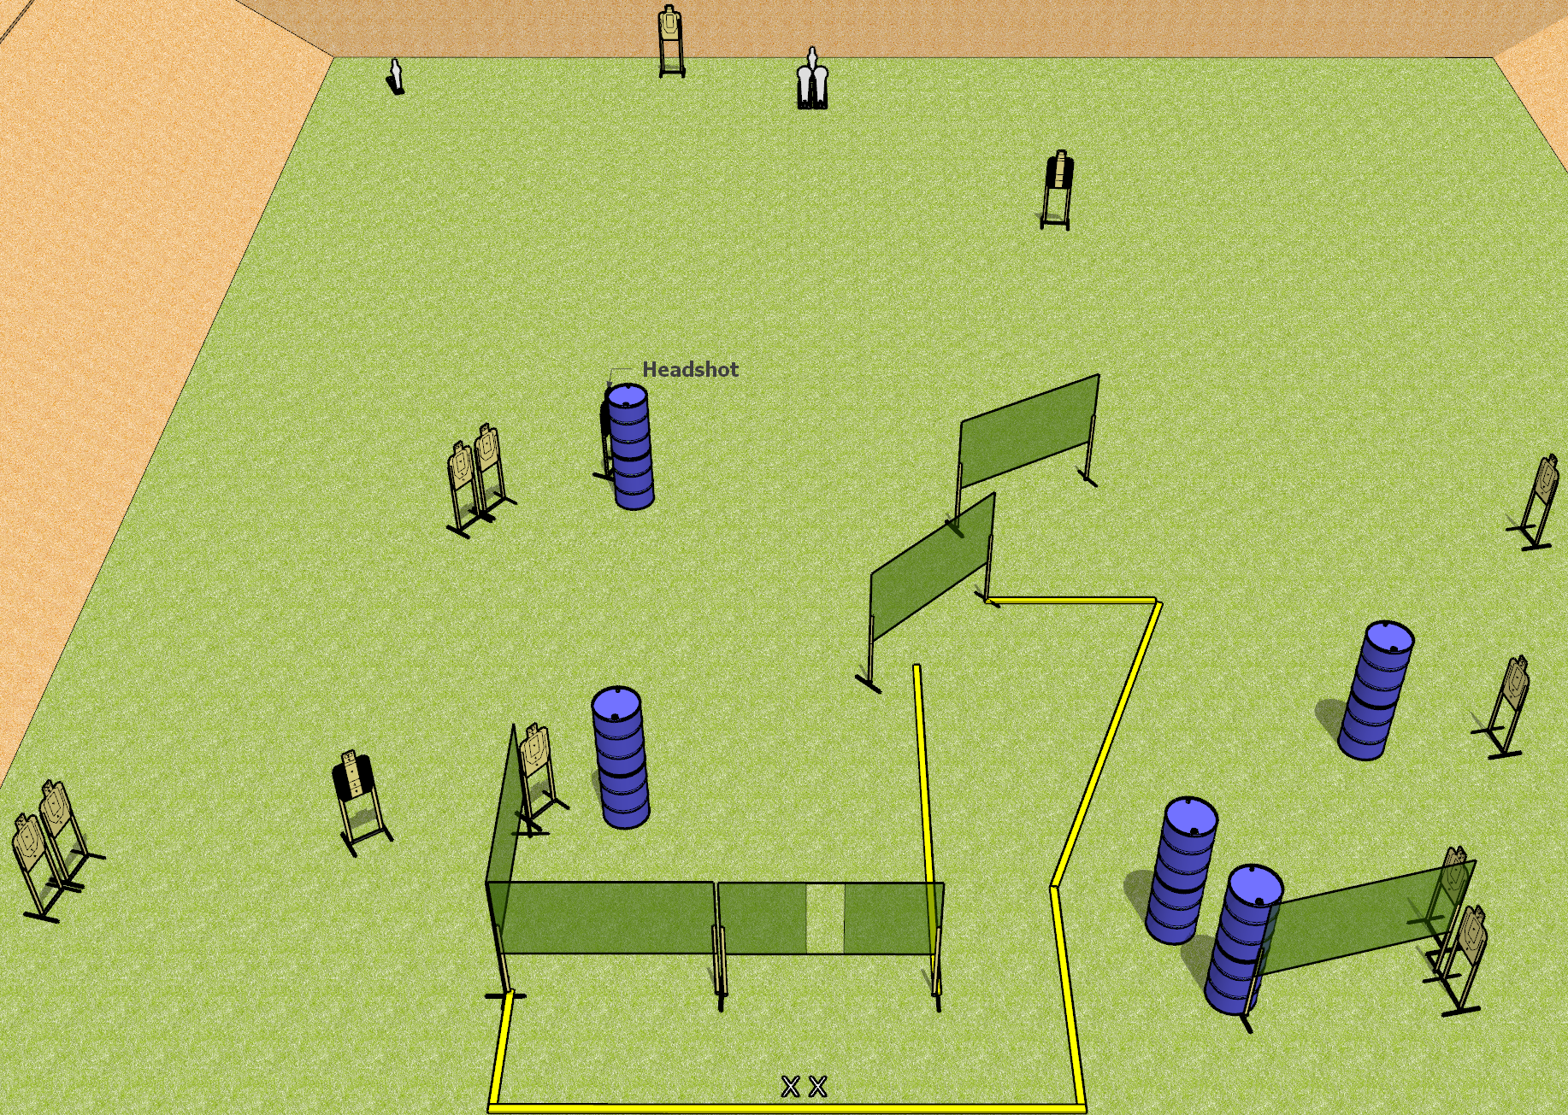
 | Dothan Gun Club – USPSA Match Rage Inducing Course Designer : Drew Coleman
Round Count 30 rounds 13 USPSA targets 2 colt poppers, 2 USPSA mini poppers
Equipment List 10 wall feet 2 Tuxedos, 1 headshot target

Slide 2
Rage Inducing
Written Stage Briefing
Rage Inducing is a 30 round, 150 point, Comstock field course. There are 13 USPSA targets, 2 colt poppers, and 2 USPSA mini poppers. The best 2 hits on paper will score, and steel must fall to score. The start signal is audible.
Handgun start position is both feet on X’s, wrists below belt. Handgun is loaded and holstered.
PCC start position is both feet on X’s. Loaded carbine is held with both hands, stock on belt, safety on.
On start signal, engage targets as they become available from within the shooting area.

